Slide 1



Resume Project Challenge no. 8 (BFSI)
View in Power BI
Last data refresh:
1/21/2024 10:23:50 AM UTC
Downloaded at:
1/21/2024 10:29:01 AM UTC

Slide 2
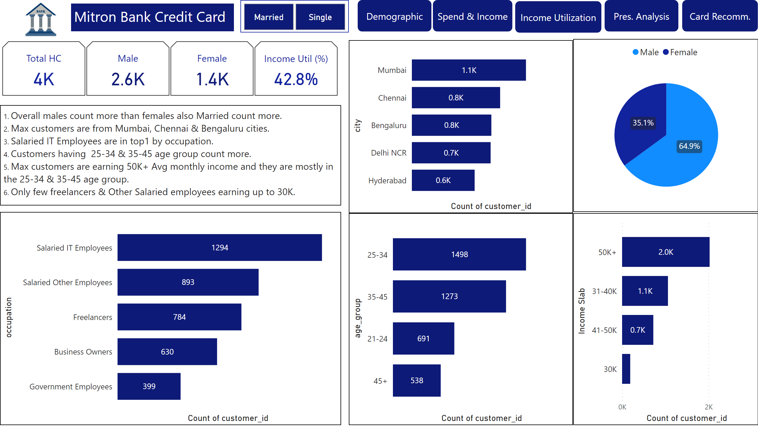
Demographic Class.
Notes:
cardVisual
No alt text provided
barChart
No alt text provided
barChart
No alt text provided
textbox
No alt text provided
image
No alt text provided
barChart
No alt text provided
barChart
No alt text provided
textbox
No alt text provided
shape
hi
shape
hi
shape
hi
shape
hi
shape
hi
advancedSlicerVisual
No alt text provided
pieChart
No alt text provided

Slide 3
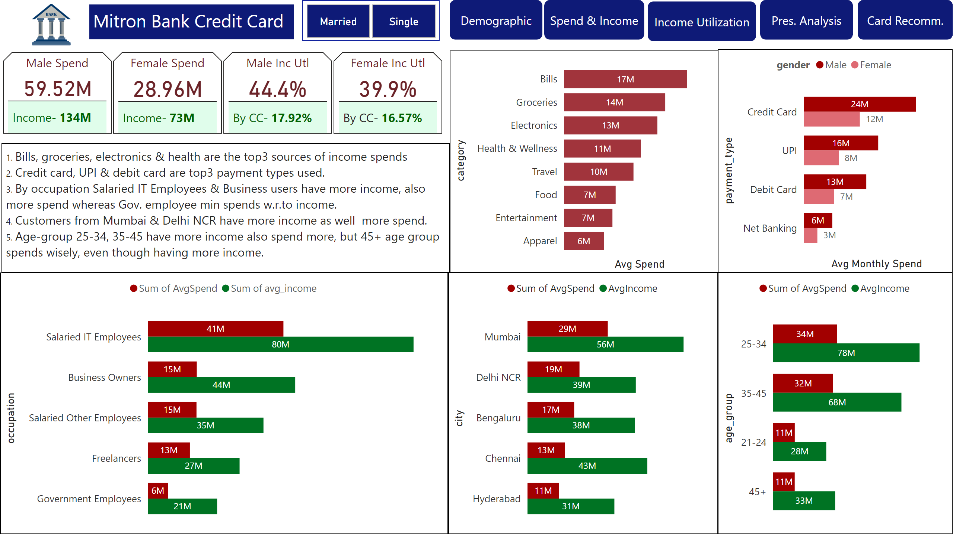
Spends Vs Income
Notes:
clusteredBarChart
No alt text provided
textbox
No alt text provided
image
No alt text provided
AvgSpend by payment_type
No alt text provided
textbox
No alt text provided
clusteredBarChart
No alt text provided
clusteredBarChart
No alt text provided
cardVisual
No alt text provided
clusteredBarChart
No alt text provided
shape
hi
shape
hi
shape
hi
shape
hi
shape
hi
advancedSlicerVisual
No alt text provided

Slide 4
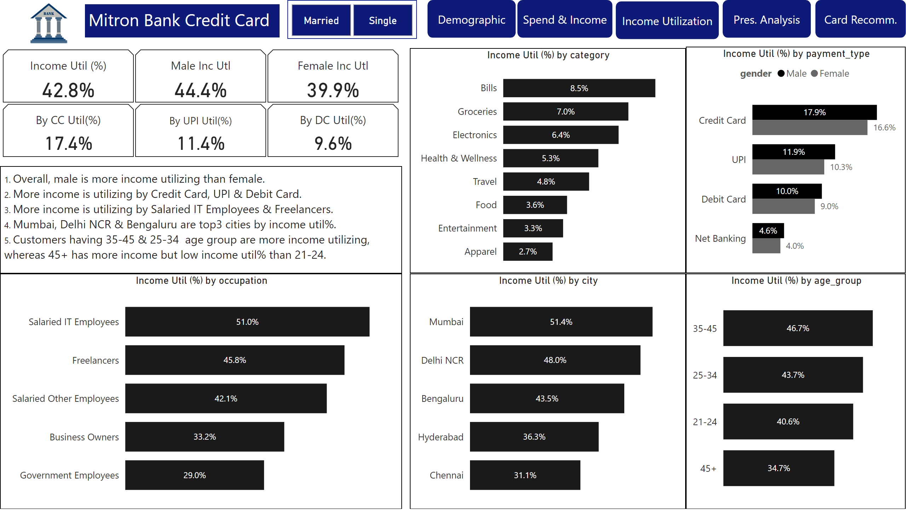
Income Utilization
Notes:
cardVisual
No alt text provided
clusteredBarChart
No alt text provided
textbox
No alt text provided
image
No alt text provided
Income Util (%) by payment_type
No alt text provided
textbox
No alt text provided
clusteredBarChart
No alt text provided
barChart
No alt text provided
barChart
No alt text provided
shape
hi
shape
hi
shape
hi
shape
hi
shape
hi
advancedSlicerVisual
No alt text provided

Slide 5
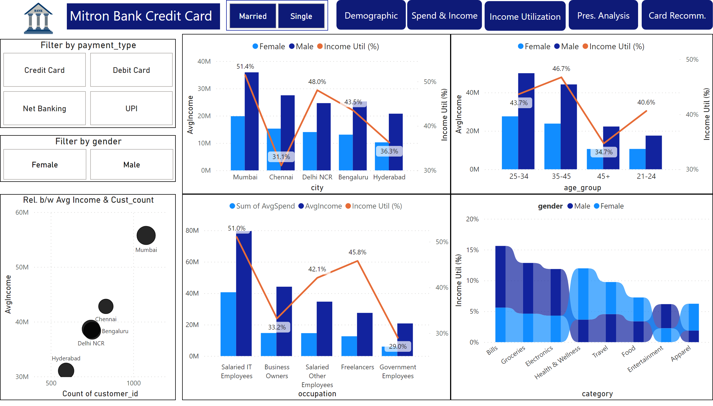
Prescr. Analysis
Notes:
Rel. b/w Avg Income & Cust_count
No alt text provided
lineClusteredColumnComboChart
No alt text provided
lineClusteredColumnComboChart
No alt text provided
ribbonChart
No alt text provided
shape
hi
shape
hi
shape
hi
shape
hi
shape
hi
textbox
No alt text provided
advancedSlicerVisual
No alt text provided
image
No alt text provided
Filter by payment_type
No alt text provided
Filter by gender
No alt text provided
lineClusteredColumnComboChart
No alt text provided

Slide 6
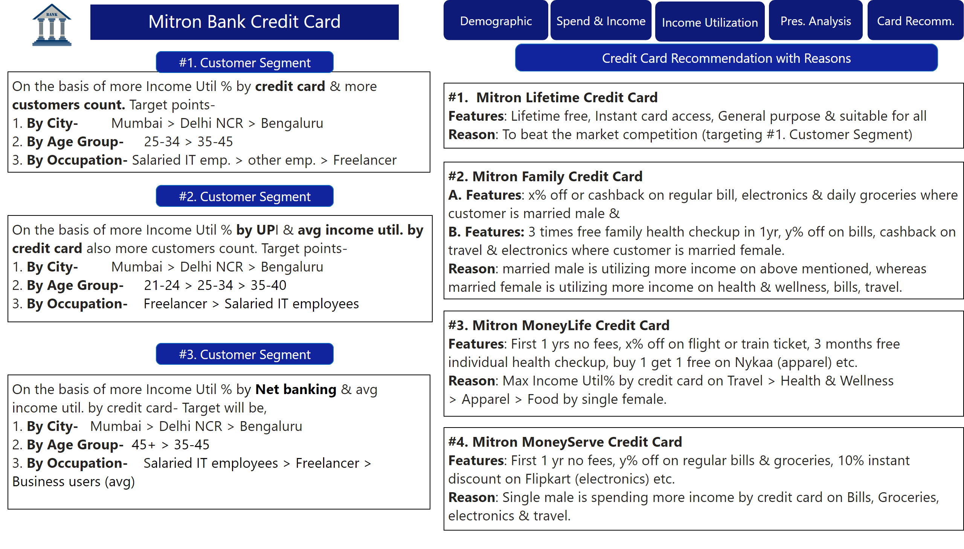
Card Recommend.
Notes:
textbox
No alt text provided
shape
hi
shape
hi
shape
hi
shape
hi
shape
hi
textbox
No alt text provided
image
No alt text provided
shape
No alt text provided
textbox
No alt text provided
textbox
No alt text provided
textbox
No alt text provided
textbox
No alt text provided
textbox
No alt text provided
shape
No alt text provided
shape
No alt text provided
shape
No alt text provided
textbox
No alt text provided

Slide 7
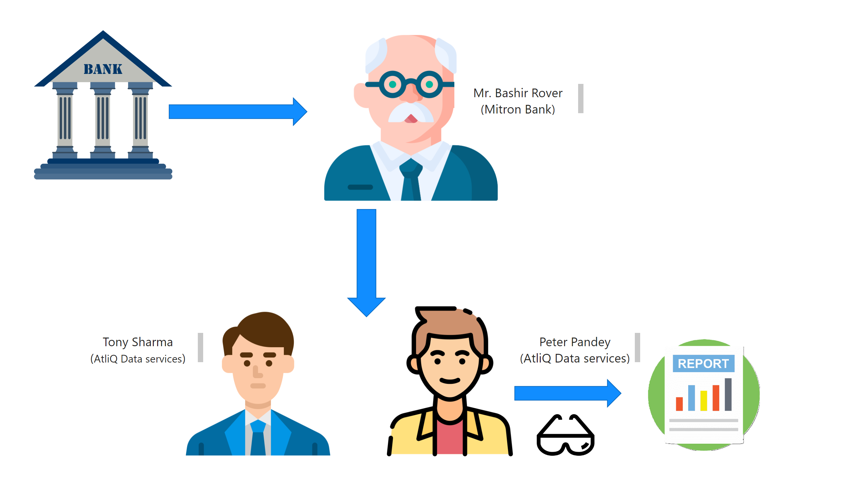
PS
Notes:
image
No alt text provided
image
No alt text provided
image
No alt text provided
shape
No alt text provided
image
No alt text provided
image
No alt text provided
shape
No alt text provided
image
No alt text provided
shape
No alt text provided
textbox
No alt text provided
textbox
No alt text provided
textbox
No alt text provided

